Slide 1
Bardia Bandali
CEG4131 – Fall 2012
GPU
CEG4131 – Fall 2012
University of Ottawa
Notes:
Introduction
GPU
Programming

Slide 2
Introduction
History
Graphic Elements
Graphic Pipeline
Vector Processors
History
Graphic Elements
Graphic Pipeline
Vector Processors
Stream Processors
Graphics Processing Unit

Slide 3
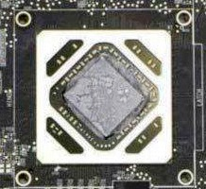
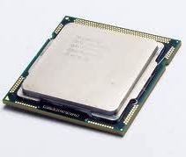
Introduction
History
Graphic Elements
Graphic Pipeline
Vector Processors
(CPU ~ GPU) ?
CPU: Intel Core i7
GPU: AMD Tahiti
General purpose
Programme & Do whatever you want! Of course with proper IO, peripheral and memory.
Special purpose
No!!?

Slide 4
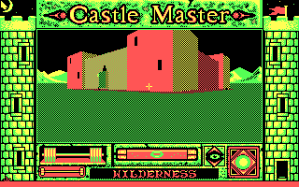
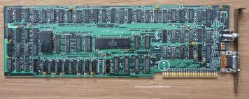
Introduction
History
Graphic Elements
Graphic Pipeline
Vector Processors
Color Graphic Adapter (CGA 1981)
4 bit RGBI
40 x 25 Characters
320 x 200 Pixel, 16 Colors
640 x 200 Pixel Maximum
16 Kilo Byte Memory

Slide 5
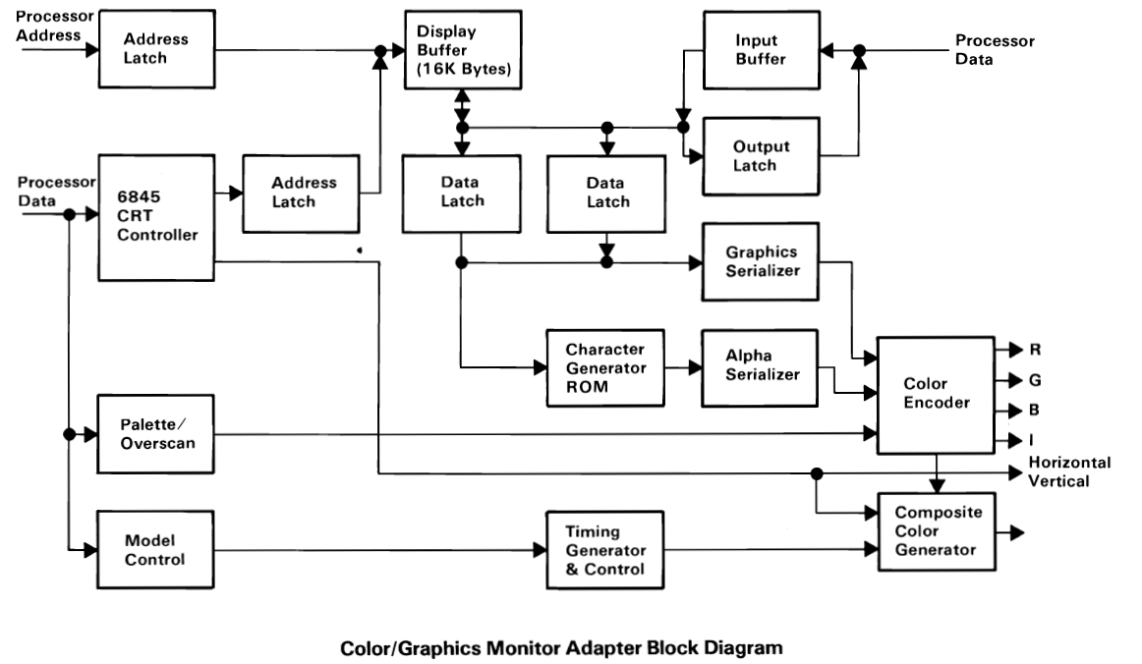
Introduction
History
Graphic Elements
Graphic Pipeline
Vector Processors
CGA...
, Need Is The Mother Of Inventions...
IBM Color Graphics Adapter Manual

Slide 6
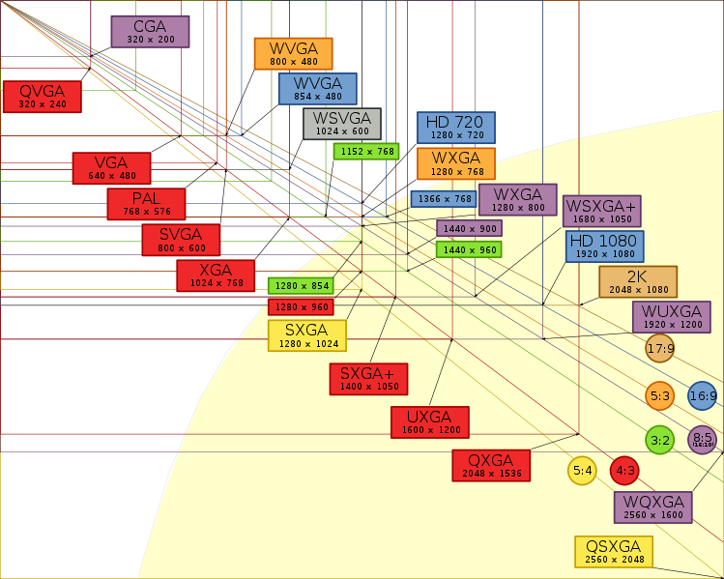
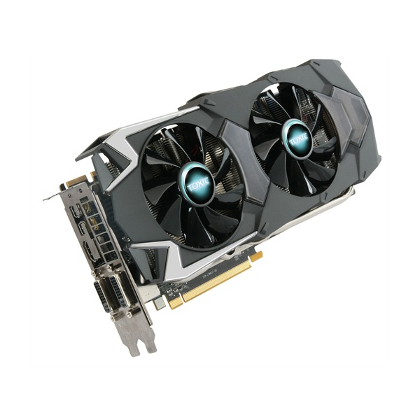
Introduction
History
Graphic Elements
Graphic Pipeline
Vector Processors
Video Standards:
AMD HD7970
36 bit RGBI (68720 Million Colors)
16384 x 16384 Pixels (Six Monitor)
6,291,456 Kilo Byte Memory
Wikipedia
Sapphire Technology HD7970

Slide 7
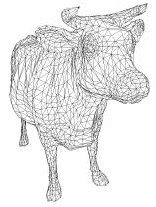
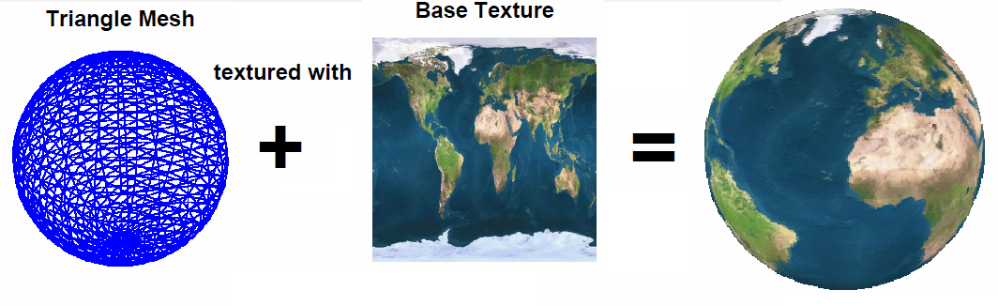
Introduction
History
Graphic Elements
Graphic Pipeline
Vector Processors
Graphic Elements:
Objects: Any 2D or 3D entity whose shape could be represented by mesh of arbitrary polygons.
Polygons: are composed of vertices and edges. Most of the time triangles are used for simplicity and generality. Each polygon can be represented by a list of 3D coordinates of its vertices.
Vertex: A point with 3D coordinate and color.
Pixel: A computer image is represented by an array of points called pixel with its own color and coordinate (address).
Color: The color of each pixel is described by three numbers for intensity of main colors: red, green, and blue, e.g. (255, 0, 255). Range of numbers defines total number of colors (in above example three 8bit numbers provide 2^24=16777216 colors).
Resolution: The number of pixels in an image determines the resolution of the image, e.g. 320x200, 2560x2048.
Mesh: A grid of polygons to represent an object.
Primitive: Classical geometric shapes can be directly used as primitives (e.g. point, line, cube, cylinder, sphere...) to make parts of objects.
Texture: An image that is mapped on the surface of polygons on objects to provide a concept of specific material. The vertices of polygons contain coordinates of the texture.
Fragment: All necessary data needed to generate a single pixel of final image in output memory, e.g. coordinates, color, depth, texture coordinate, blending...
F. Durand, “A Short Introduction to Computer Graphics”, MIT Laboratory for Computer Science
R. Fernando, C. Zeller, “Programming Graphics Hardware Programming Hardware”, NVIDIA.
Notes:
A caw modeled as a mesh of triangles.

Slide 8
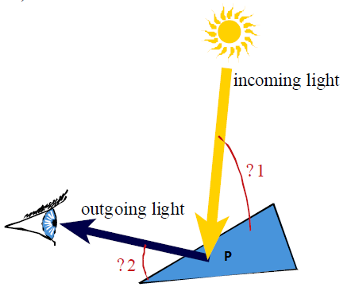
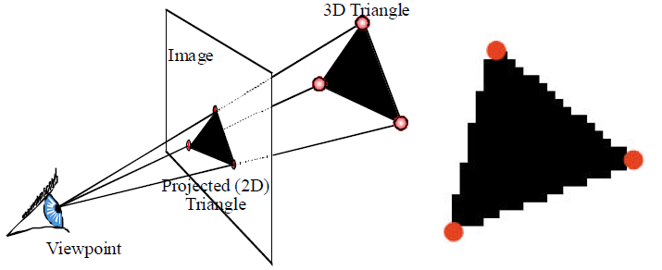
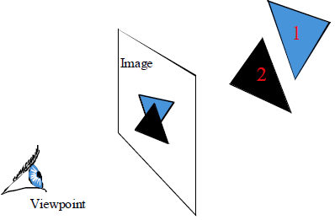
Introduction
History
Graphic Elements
Graphic Pipeline
Vector Processors
Graphic Pipeline:
Several mathematical computation stages to realize 3D virtual scenes into 2D images.
Geometry-Stage:
Lighting Process
Rasterization-Stage:
Visibility
Rasterization
F. Durand, “A Short Introduction to Computer Graphics”, MIT Laboratory for Computer Science
Notes:
One of the most important reasons of improving graphic cards was to realize 3D virtual scenes into 2D images. Rendering an image is performed by doing various processes on four basic elements: vertices, primitives, fragments, and pixels. This could be done by passing data through several mathematical computation stages called Graphics Pipeline.
All objects in a 3D scene should be transformed to unique system with their own coordinations. Transformations are done by multiplication with translation, rotation and scaling matrices.
Next, lighting properties of all vertices should be found by considering a light source and a viewer at desired point and their angle.
Drawing covered pixels by the primitives (line or triangle) is called rasterization. Each primitive generates a set of fragments, which all of its properties, including color, texture, depth and visibility, should be calculated in this stage.

Slide 9
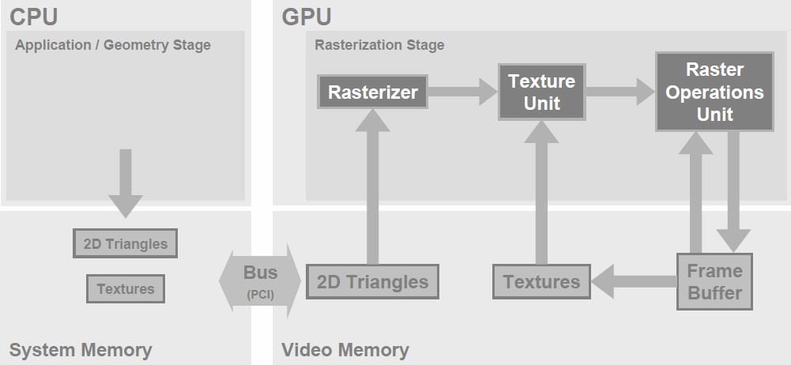
Introduction
History
Graphic Elements
Graphic Pipeline
Vector Processors
Graphic Pipeline...
Primary hardware pipeline
R. Fernando, C. Zeller, “Programming Graphics Hardware Programming Hardware”, NVIDIA.

Slide 10
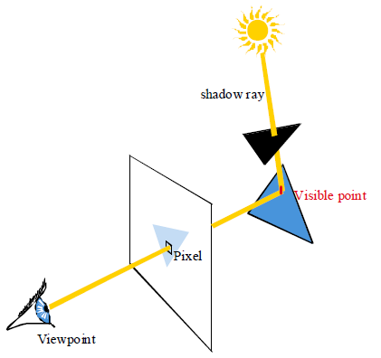
Introduction
History
Graphic Elements
Graphic Pipeline
Vector Processors
Graphic Pipeline...
Shading-Stage:
Ray trace shadow finding
R. Fernando, C. Zeller, “Programming Graphics Hardware Programming Hardware”, NVIDIA.
Notes:
Enhancing the scene with multiple light sources and reflections allows for better rendering. So, the objects should be shaded according to their interaction with light sources. As a result, two other stages, vertex shading and pixel shading, were added in 2001. There are various methods of shading.
A shadow ray is considered from the light source to the visible point of the object, if the ray passes the surface then the point is in shadow. In this method, shadow calculations must be performed for all pixels and each light source separately.

Slide 11
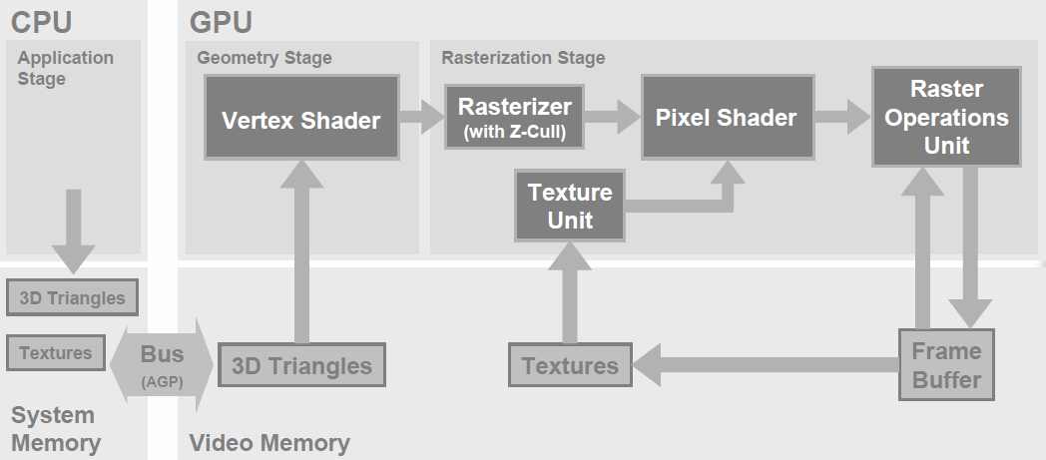
Introduction
History
Graphic Elements
Graphic Pipeline
Stream Processors
Graphic Pipeline...
Pipeline with Shading Stages
R. Fernando, C. Zeller, “Programming Graphics Hardware Programming Hardware”, NVIDIA.
CEG 4131-Fall 2012 11
Notes:
Although, shading stages were fixed functions at the beginning, emergence of new shading algorithms transformed them to be programmable a few years afterward. In figure 2.2.5 vertex shader and pixel shader blocks are programmable.

Slide 12
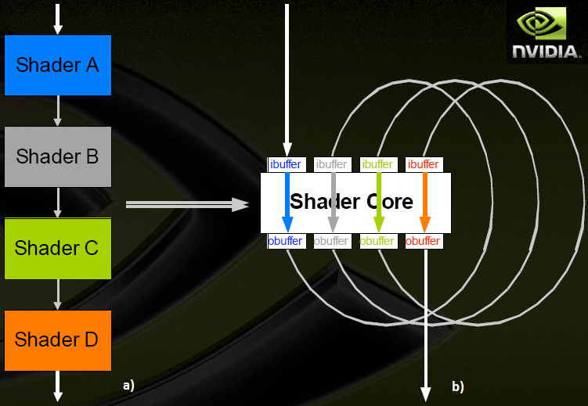
Introduction
History
Graphic Elements
Graphic Pipeline
Vector Processors
Graphic Pipeline...
a) Serial pipeline b) Unified pipeline
R. Fernando, C. Zeller, “Programming Graphics Hardware Programming Hardware”, NVIDIA.
CEG 4131-Fall 2012 12
CEG 4131-Fall 2012 12
Notes:
The final evolution pace toward modern pipeline was done by ATI Company in 2005. They introduced a Unified Shader in the Xenos chip for Xbox 360 game console. Unified shader incorporates a large block of parallel floating processors for all shader stages, instead of serializing several shading stages.
Before introducing unified shader, GPU resources were under-utilized and sometimes limited the programmers.
For example, one application or part of an application may require a large amount of vertex shading and other application or parts may require a little pixel shading. A unified shader can dynamically allocate variable amount of its parallel processor for each shading algorithm or stage.

Slide 13
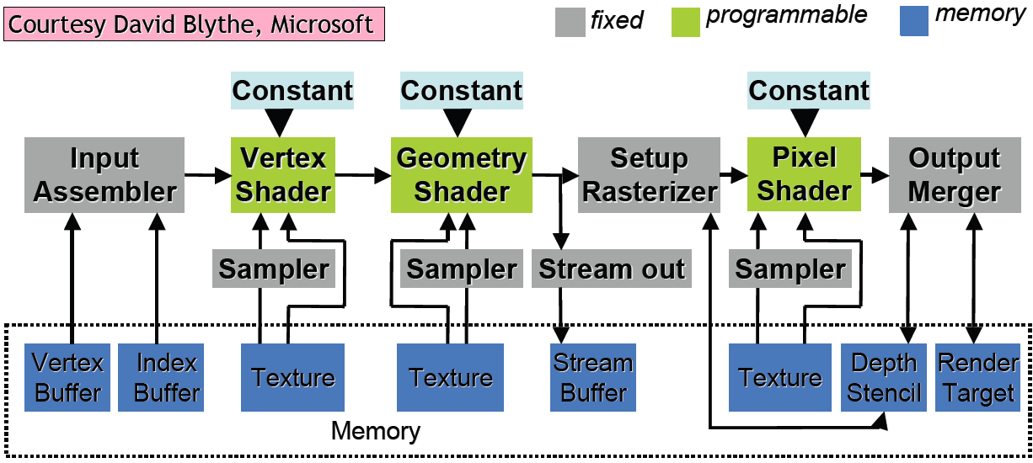
Introduction
History
Graphic Elements
Graphic Pipeline
Vector Processors
Graphic Pipeline...
Microsoft Direct3D-10 pipeline stages
R. Fernando, C. Zeller, “Programming Graphics Hardware Programming Hardware”, NVIDIA.
CEG 4131-Fall 2012 13
CEG 4131-Fall 2012 13
CEG 4131-Fall 2012 13
Notes:
Now, it is useful to take a look at Direct3D-10 pipeline from Microsoft and compare it with previous pipelines,

Slide 14
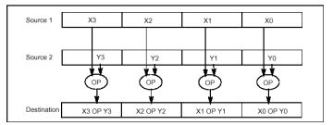
Introduction
History
Graphic Elements
Graphic Pipeline
Vector Processors
Speedup: Data Parallelism or Loop Level Parallelism
Single Instruction Multiple Data (SIMD)
Multimedia SIMD
Vector Processors
Stream Processors
Graphics Processing Unit
CEG 4131-Fall 2012 14
CEG 4131-Fall 2012 14
CEG 4131-Fall 2012 14
CEG 4131-Fall 2012 14
Notes:
Data parallelism or loop level parallelism is the idea to achieve speedup by simultaneous operation on large group or stream of data on parallel processors, rather than dividing operation between parallel tasks or threads. In fact, in data parallelism cores do the same task on different parts of data, while in task parallelism cores do different tasks on different data. The implementation of this idea in hardware is done by Single Instruction Multiple Data architecture.
Intel added multimedia SIMD instruction set (MMX) in 1996 to its processors. But it was not possible to simultaneously operate on 16 operands, until they introduced Streaming SIMD Extensions (SSE) in 1999. SSE instruction set improved to SSE2 and SSE4 with performing double precision floating point operations.

Slide 15
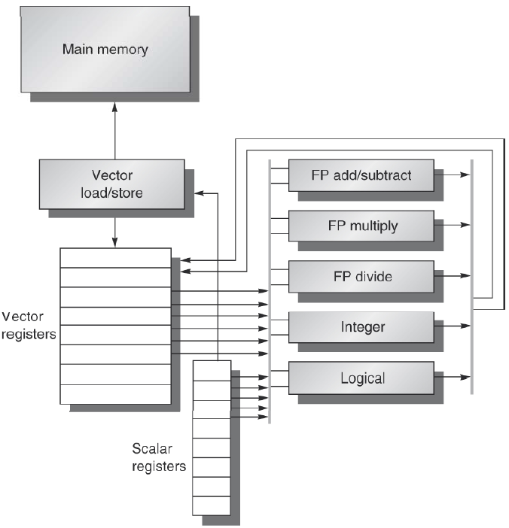
Introduction
History
Graphic Elements
Graphic Pipeline
Vector Processors
Vector Processor
J. Hennessy, D. Patterson, “Computer Architecture: A Quantitative Approach”, 5th Edition, 2012, Elsevier Inc
.
CEG 4131-Fall 2012 15
CEG 4131-Fall 2012 15
CEG 4131-Fall 2012 15
CEG 4131-Fall 2012 15
CEG 4131-Fall 2012 15
Notes:
Using SIMD in vector processing was first introduced in CDC-11 and TI-ASC supercomputers in early 1970s, and popularized by Cray supercomputers in next decade. In a vector processor, large amount of scattered data are read from memory to register files, then a single instruction operation is executed on these registers and finally results are written back to the memory.
The difficulty of using vector processing is memory access. In order to benefit from parallel data processing, data vectors must be supplied as fast as possible. So, vector processor must have multiple memory banks instead of sequential access or interleaving.
For example Cray T932 needs 1344 memory banks to operate on full memory bandwidth.
Recently both Intel and AMD added Advanced Vector Extensions (AVX) instructions to their instruction set of Sandy-Bridge and Bulldozer architecture.

Slide 16
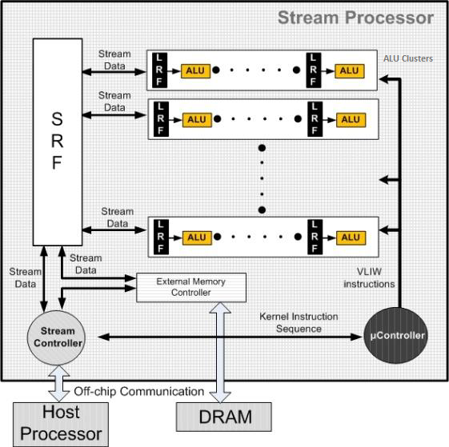
History
Graphic Elements
Graphic Pipeline
Vector Processors
Stream Processors
Stream Processor
Streams
Kernels
Famous Stream Processors:
1- Imagine
2- Merrimac
3- FT64
4- Storm-1
U.J. Kapasi, et al, “Programmable Stream Processors,” IEEE Computer, Aug 2003, pp. 54-62.
CEG 4131-Fall 2012 16
CEG 4131-Fall 2012 16
CEG 4131-Fall 2012 16
CEG 4131-Fall 2012 16
CEG 4131-Fall 2012 16
CEG 4131-Fall 2012 16
Notes:
Stream processing model is based on arranging applications into groups of small computational kernels that operate and may inter-operate on streams of data.
Streams are sets of data with the same type, which may be single numbers or complex structures.
A set of operations, simple or complex computations, that performs on input stream elements and provides at least one output stream is a kernel.
All kernel instructions and stream transfers are sent by host processor to stream controller. Also, the stream controller is responsible for communication with the host processor. The uController receives SIMD instructions from stream controller and sends them to all ALU clusters. If instruction scheduling could be done by compiler, it is possible to incorporate VLIW instructions. Finally, external memory controller module handles stream transfer between external memory and internal SRF.

Slide 17
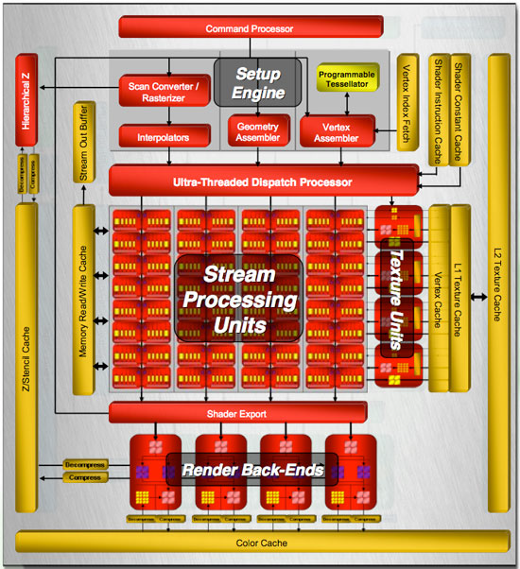
Graphic Elements
Graphic Pipeline
Vector Processors
Stream Processors
Graphics Processors
Graphics Processors
Work-item: Each kernel instance is a work-item or thread.
Work-group: work-items are organized into clusters called work-groups. Within a work-group, work-items can share data in local memory and all work-items within a group execute on the same stream processor array.
Wave-front: A wave-front is group of threads (work-item) that execute together.
Clause: Homogenous group of instructions run automatically on the hardware.
Command processor
Ultra Dispatch Processor (UDP)
Stream Engine
Stream Processing Unit
General Purpose Registers
D. Wilson, “ATI Radeon HD 2900 XT: Calling a Spade a Spade”, 2007, www.anandtech.com
CEG 4131-Fall 2012 17
CEG 4131-Fall 2012 17
CEG 4131-Fall 2012 17
CEG 4131-Fall 2012 17
CEG 4131-Fall 2012 17
CEG 4131-Fall 2012 17
Notes:
Command processor: It is the first module in the GPU and is responsible for command and stream fetching, state control and register management. It also includes separate queues for commands, streams and kernels, DMA for streams and interrupt control unit.
UDP: Main control unit for the shader core is UDP. It distributes workloads into 64 threads and could handle up to 100 threads in flight to hide latency. It can inhibit threads which are waiting for resources. Also, it contains a programmable arbitration and sequencer for all resources.
Stream Engine: It is also called Compute Units, includes 4 SIMD arrays of each contains 16 Stream Processing Units (SPU) totally 320 processing elements.
General Purpose Registers: GPRs are multi-ported shared register files for each SPU.

Slide 18
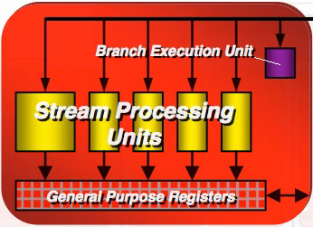
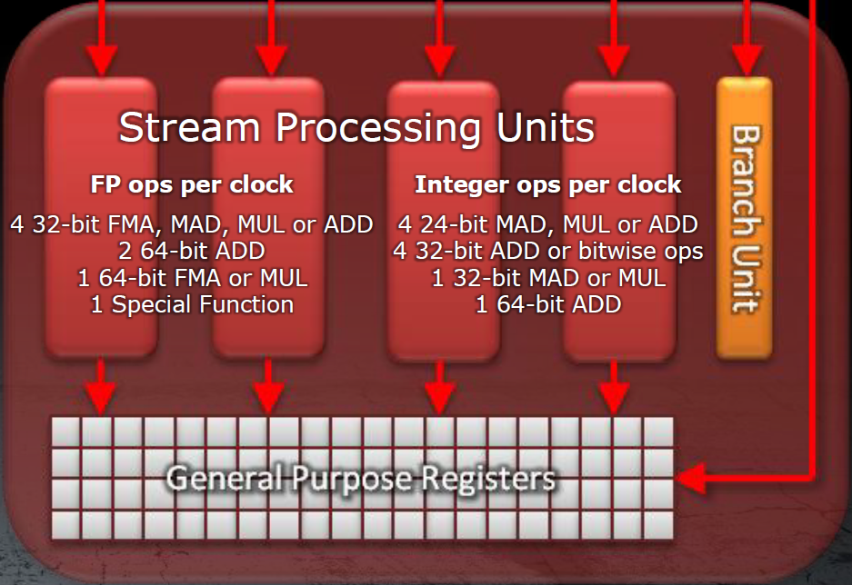
Graphic Elements
Graphic Pipeline
Vector Processors
Stream Processors
Graphics Processors
Graphics Processors...
VLIW5 vs VLIW4 SPU Architecture
D. Wilson, “ATI Radeon HD 2900 XT: Calling a Spade a Spade”, 2007, www.anandtech.com
AMD Radeon HD 6900 Series Graphics, Dec 2010, AMD.
CEG 4131-Fall 2012 18
CEG 4131-Fall 2012 18
CEG 4131-Fall 2012 18
CEG 4131-Fall 2012 18
CEG 4131-Fall 2012 18
CEG 4131-Fall 2012 18
CEG 4131-Fall 2012 18
Notes:
Stream Processing Unit: Each SPU contains 5 Processing Elements (stream processor), which works on 4 separate elements, performing 5 scalar instructions during 4 cycles. It is arranged as 5 way shader processor capable of executing 5 scalar floating point multiply-add (or 5 integer operations). The Branch Execution Unit is considered separately and handles flow control and branch predication directly in ALUs.
Previous 5 way SPU (VLIW5) design has been chosen by ATI to cover their vertex shader algorithm which used 4 FP component dot product (w, x, y, z) and one scalar for lighting at the same time. Recently researchers found that new algorithms seldom use the fifth processor, and it is underutilized. So, they changed the SPU to VLIW4 architecture with equal functionality for processors, and used space of fifth processor to increase the performance and number of SPUs. As a result, Cayman has 24 SIMD engines (totally 1536 processing elements), 96 texture units, and supports 64bit math as well.

Slide 19
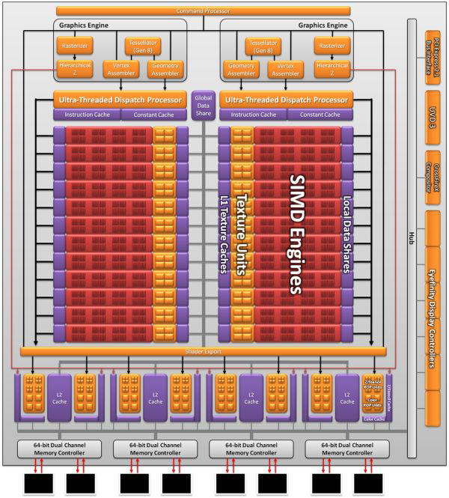
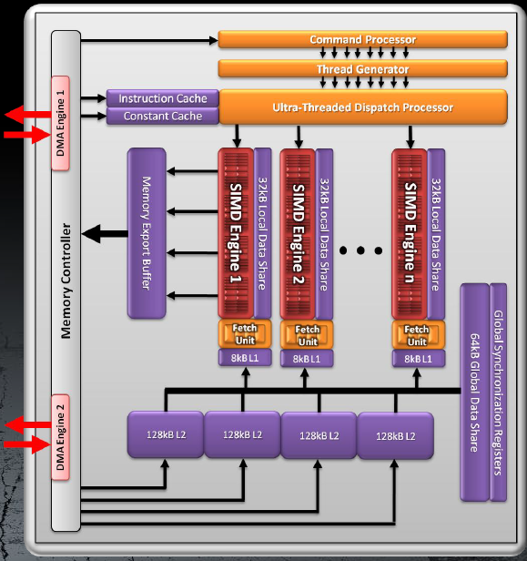
Graphic Elements
Graphic Pipeline
Vector Processors
Stream Processors
Graphics Processors
Graphics Processors...
AMD Radeon HD 6900 Series Graphics, Dec 2010, AMD.
CEG 4131-Fall 2012 19
CEG 4131-Fall 2012 19
CEG 4131-Fall 2012 19
CEG 4131-Fall 2012 19
CEG 4131-Fall 2012 19
CEG 4131-Fall 2012 19
CEG 4131-Fall 2012 19
CEG 4131-Fall 2012 19
Notes:
The Ultra dispatch processor is two separate modules, which operate asynchronously. Each dispatch module contains 8KByte instruction cache and 24KByte constant cache. In contrast with previous GPUs which had only one shared command queue, now every kernel has its own command queue with protected address space. So, applications can share GPUs resources more efficiently and exploit better task level parallelism. Dispatch processors manage executing kernels and schedule wave-fronts to cores and fixed function hard-wares. Pixel kernels are assigned in tile manner according to screen dimension, and round-robin arbitration method is used to distribute other kernels (e.g. vertex and geometry). Moreover, round-robin arbitration is used to divide compute kernels between two dispatch processors.
Each dispatch processor has a pool for 248 wave-fronts (could be in-flight) in order to hide latency of internal pipeline length and external memory access. The wave-front scheduling is programmable and could be prioritized between different kernel types (vertex, pixel, geometry, compute) with Least Recently Used (LRU) prioritization within the same kernel type. Each time a dispatch processor can select two ready wave-fronts to dispatch for execution.

Slide 20
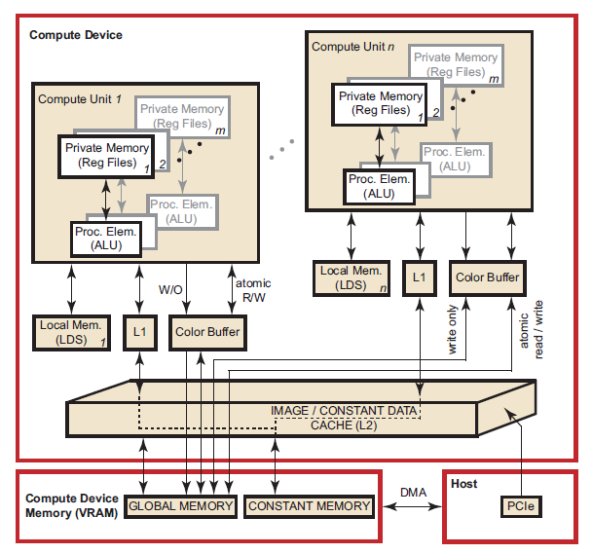
Graphic Elements
Graphic Pipeline
Vector Processors
Stream Processors
Graphics Processors
Graphics Processors...
Private Memory (GPR)
Local Memory (LDS)
Global Memory (GDS)
Constant Memory
Interrelationship of Memory Domains for Southern Islands Devices
AMD Accelerated Parallel Processing 2012
CEG 4131-Fall 2012 20
CEG 4131-Fall 2012 20
CEG 4131-Fall 2012 20
CEG 4131-Fall 2012 20
CEG 4131-Fall 2012 20
CEG 4131-Fall 2012 20
CEG 4131-Fall 2012 20
CEG 4131-Fall 2012 20
CEG 4131-Fall 2012 20
Notes:
Private memory - specific to a work-item; it is not visible to other work-items.
Local memory - specific to a work-group; accessible only by work-items belonging to that work-group.
Global memory - accessible to all work-items executing in a context, as well as to the host (read, write, and map commands).
Constant memory - read-only region for host-allocated and -initialized objects that are not changed during kernel execution.
Host (CPU) memory - host-accessible region for an application’s data structures and program data.
PCIe memory - part of host (CPU) memory accessible from, and modifiable by, the host program and the GPU compute device.

Slide 21
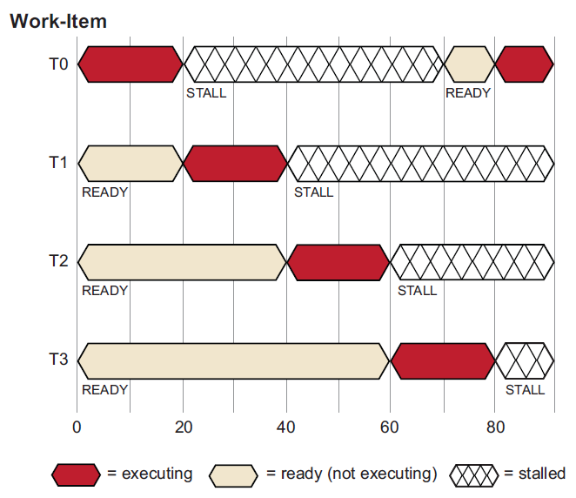
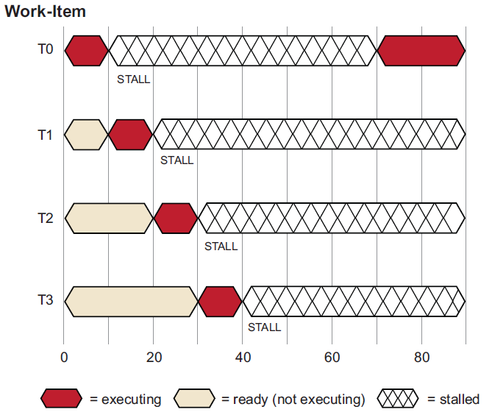
Graphic Elements
Graphic Pipeline
Vector Processors
Stream Processors
Graphics Processors
Graphics Processors...
Task Scheduling
AMD Accelerated Parallel Processing 2012
CEG 4131-Fall 2012 21
CEG 4131-Fall 2012 21
CEG 4131-Fall 2012 21
CEG 4131-Fall 2012 21
CEG 4131-Fall 2012 21
CEG 4131-Fall 2012 21
CEG 4131-Fall 2012 21
CEG 4131-Fall 2012 21
CEG 4131-Fall 2012 21
CEG 4131-Fall 2012 21
Notes:
GPU hides memory latency to the application by pipelining thousands of work-items in different stages of execution, and by overlapping compute operations with memory-access operations. The resource scheduler switch the active wave-front in a compute unit when the current wave-front is waiting for a memory access to complete. This would be possible if work-items contain a large number of ALU operations per memory load/store.
At the beginning, work-items are queued and waiting for execution. Then, work-item T0 executes until cycle 20 when a stall occurs due to a memory fetch request. The scheduler then begins execution of the next work-item, T1. work-item T1 executes until it stalls or completes. New work-items execute, and the process continues until the available number of active work-items is reached. The scheduler then returns to the first work-item, T0. If the data work-item T0 is waiting for has returned from memory, T0 continues execution. In this example the data is ready, so T0 continues. Since there were enough work-items and processing element operations to cover the long memory latencies, the stream processor does not idle. If none of T0–T3 are runnable, the stream processor waits (stalls) until one of T0–T3 is ready to execute.

Slide 22
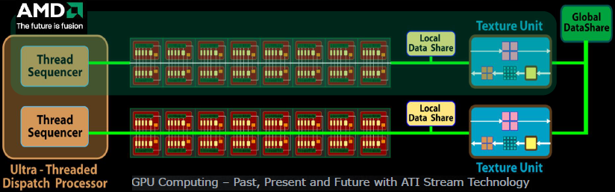
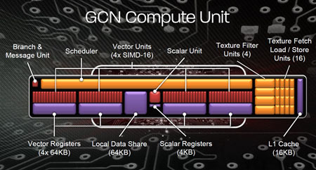
Graphic Elements
Graphic Pipeline
Vector Processors
Stream Processors
Graphics Processors
Graphics Processors...
AMD GRAPHICS CORES NEXT (GCN) ARCHITECTURE 2012
CEG 4131-Fall 2012 22
CEG 4131-Fall 2012 22
CEG 4131-Fall 2012 22
CEG 4131-Fall 2012 22
CEG 4131-Fall 2012 22
CEG 4131-Fall 2012 22
CEG 4131-Fall 2012 22
CEG 4131-Fall 2012 22
CEG 4131-Fall 2012 22
CEG 4131-Fall 2012 22
CEG 4131-Fall 2012 22

Slide 23
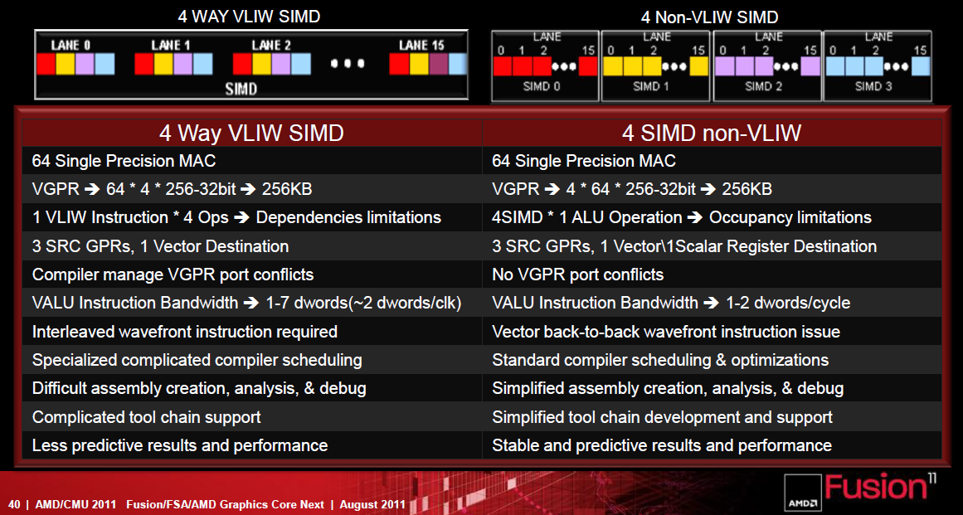
Graphic Elements
Graphic Pipeline
Vector Processors
Stream Processors
Graphics Processors
Graphics Processors...
CEG 4131-Fall 2012 23
CEG 4131-Fall 2012 23
CEG 4131-Fall 2012 23
CEG 4131-Fall 2012 23
CEG 4131-Fall 2012 23
CEG 4131-Fall 2012 23
CEG 4131-Fall 2012 23
CEG 4131-Fall 2012 23
CEG 4131-Fall 2012 23
CEG 4131-Fall 2012 23
CEG 4131-Fall 2012 23

Slide 24
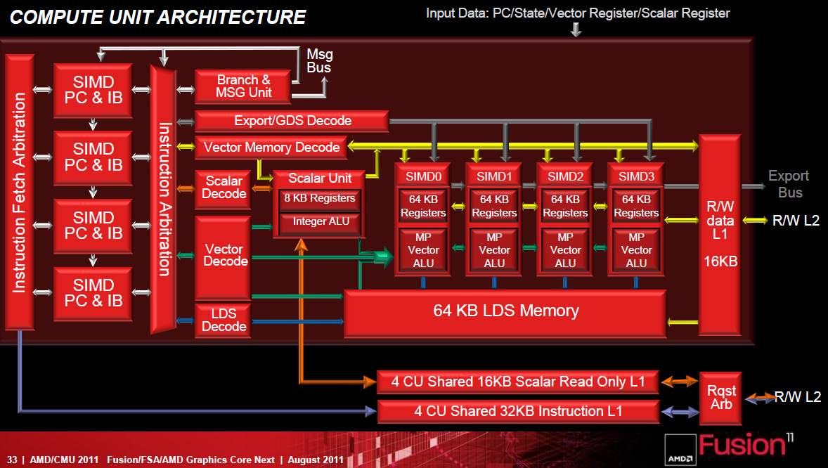
Graphic Elements
Graphic Pipeline
Vector Processors
Stream Processors
Graphics Processors
Graphics Processors...
CEG 4131-Fall 2012 24
CEG 4131-Fall 2012 24
CEG 4131-Fall 2012 24
CEG 4131-Fall 2012 24
CEG 4131-Fall 2012 24
CEG 4131-Fall 2012 24
CEG 4131-Fall 2012 24
CEG 4131-Fall 2012 24
CEG 4131-Fall 2012 24
CEG 4131-Fall 2012 24
CEG 4131-Fall 2012 24
CEG 4131-Fall 2012 24

Slide 25
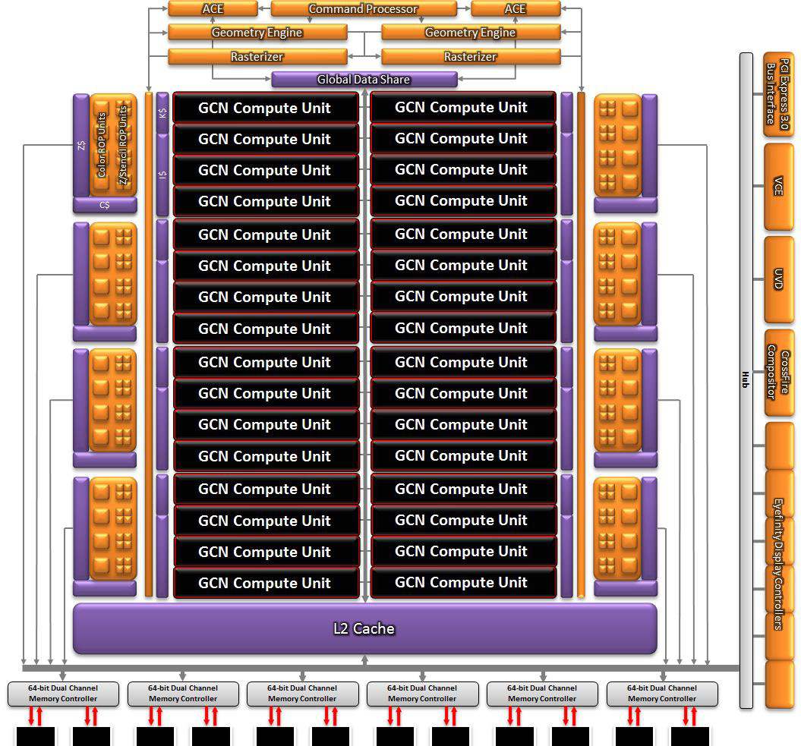
Graphic Elements
Graphic Pipeline
Vector Processors
Stream Processors
Graphics Processors
AMD Radeon HD7970
Engine clock: 1100 Mhz
Compute Units: 32
Processing Elements: 2048
Memory GDDR5
6144 Mbyte
6.4 GHz
384 bit Bus-width
Single Precision F.P: 3789 Gflops
Double Precision F.P: 947 Gflops
32b Vector Registers/CU: 65536
Vector Registers/CU: 256 KByte
LDS/CU: 64 KByte
Constant Cache/CU: 4 KByte
L1 Cache/CU: 16 KByte
L2 Cache/GPU:768 KByte
Wave-fronts/CU: 40
Wave-fronts/GPU: 1280
Work-items/GPU: 81920
AMD GRAPHICS CORES NEXT (GCN) ARCHITECTURE 2012
CEG 4131-Fall 2012 25
CEG 4131-Fall 2012 25
CEG 4131-Fall 2012 25
CEG 4131-Fall 2012 25
CEG 4131-Fall 2012 25
CEG 4131-Fall 2012 25
CEG 4131-Fall 2012 25
CEG 4131-Fall 2012 25
CEG 4131-Fall 2012 25
CEG 4131-Fall 2012 25
CEG 4131-Fall 2012 25
CEG 4131-Fall 2012 25

Slide 26
References:
[1] Http://en.wikipedia.org/wiki/File:Vector_Video_Standards2.svg
[2] M. Chu, “GPU Computing: Past, Present and Future with ATI Stream Technology”, 2010.
[3] J.D. Owens et al, “GPU Computing”, Proceeding of The IEEE, 2008
[4] F. Durand, “A Short Introduction to Computer Graphics”, MIT Laboratory for Computer Science.
[5] R. Fernando, C. Zeller, “Programming Graphics HardwareProgramming Hardware”, NVIDIA.
[6] J. Hennessy, D. Patterson, “Computer Architecture: A Quantitative Approach”, 5th Edition, 2012, Elsevier Inc.
[7] U.J. Kapasi, et al, “Programmable Stream Processors,” IEEE Computer, Aug 2003, pp. 54-62.
[8] D. Wilson, “ATI Radeon HD 2900 XT: Calling a Spade a Spade”, 2007, www.anandtech.com.
[9] AMD Radeon HD 6900 Series Graphics, Dec 2010, AMD.
[10] HD 6900 Series Instruction Set Architecture, AMD, 2011.
[11] AMD Accelerated Parallel Processing OpenCLProgramming Guide, 2012.

